Slide 1
DEPARTMENT OF LIBRARY
GOVT. GHANSHYAM SINGH GUPT P.G COLLEGE, BALOD (CG)
1 DAY LIBRARY ORIENTATION / USER EDUCATION /
INFORMATION LITERACY PROGRAMMED.

Slide 2
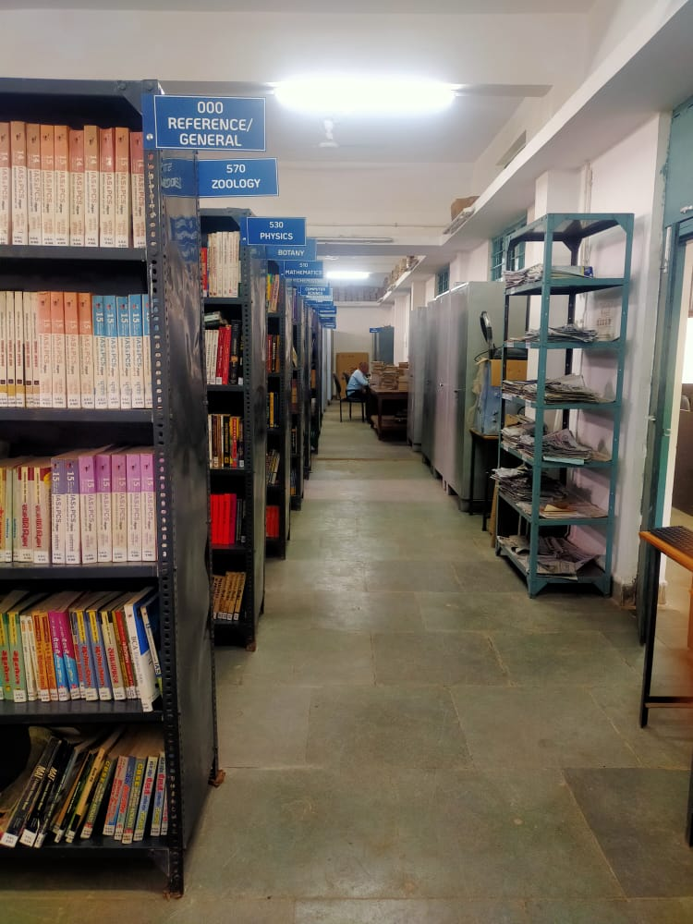
Library and Information Centre
Swami Vivekanand Library
Govt. GSG P.G. College Balod (C.G.)
Presented by
Smt. Jayanti Singh
(Librarian)
Email – jayatoppo1@gmail.com

Slide 3
LIBRARIAN PROFILE
Name – Jayanti Singh
Designation – Librarian
Date of Birth – 01.02.1964
Email Id – jayatoppo1@gmail.com
Qualification – M.A. Sociology, M lib I Sc. , M Phil
Date of Appointment – 01.04.1998
Attended Training Programs, National and International level - Workshops, Seminar
Training Programs - 05
National level- Workshops and Seminar - 04
International level - Seminar – 02
Committee member for playing report for formulation of Library rules and regulations by commissioner of directorate of higher education .
Paper setter and examiner for M. Lib & Information science.
As an Subject expert for appointment of Librarian (Contract Basis) in Govt. model higher secondary school balod.
Achievements

Slide 4
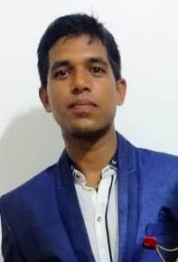
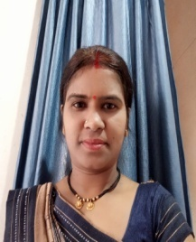
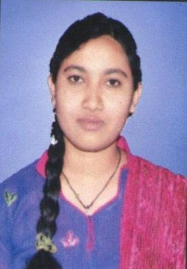
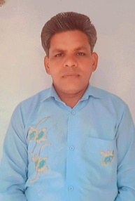
DEPARTMENT OF LIBRARY for Supporting Staff
Gaukaran Prasad DATA ENTRY OPERATOR ( JBS) ITI Copa, ITI Wireman, MA Geography | Smt. Rekha Bhardwaj BOOK LIFTER ( JBS) Graduation (BA)
Miss.Priya Yadav Asst. Laibraian ( JB) MA Hindi, ITI Copa | Mr. Keshav Ram Sahu PEON ( JBS) 12th

Slide 5
About Library
Establishment
Swami Vivekanand library came into force in 1983 with the establishment of this institution .
Library Setup
Library is managed by Librarian Smt. Jayanti Singh, accompanied by Computer operator, Peon as assistant staff appointed by Janbhagidari and book lifter.
Facilities for Library
Library has very rich collection of books numbering about 30,053.
Availability of Rare Books (C.G . Writers {571} & others ).
Book Bank facility (ST, SC, BPL).
Gifted Books (54).
Available Syllabus and Questions Paper in softcopy.
Public Library Service.
N-List (National Library and Information services Infrastructure for Scholarly Content".)
OPAC (online public access catalogue )
Important Links.
50 Seater reading room

Slide 6
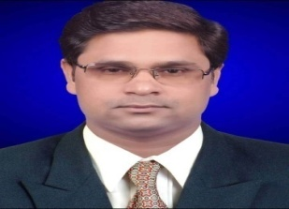
CURRENT LIBRARY ADVISORY COMMITTEE
Library committee is formed in the beginning of every academic Session by the principal in consultation with the staff members.
For further Growth and development of Library, E-library and reading room Advisory Committee members take valuable Decisions meeting twice in academic Session.
Dr. Raghwesh Panday | CONVENER
Dr. Deepali Rao | MEMBERS
Prof. Sunita Ganesh Joshi | MEMBERS
Prof. J.R. Nayak | MEMBERS

Slide 7
THE FIVE LAW OF LIBRARY SCIENCE
First Law: Books are for use.
Second Law : Every person his or her book.
Third Law : Every Books its reader.
Fourth Law : Save the time of the reader.
Fifth Law : A library is a growing organism.

Slide 8
VISION
We organize and provide access to and preserve materials to meet the needs of present and future generations of students and scholars.
We explore and implement innovative technologies and services to deliver information and scholarly resources conveniently to users anytime.
We also provide well-equipped and functional physical spaces where students can pursue independent learning and discovery outside the classroom.

Slide 9
MISSION
Our mission is to provide college students with the information they need to achieve their highest academic potential and help them acquire research skills necessary for lifelong learning.
To support teaching faculty & administrative staff and Students to participate in interactive information to exchange within the wider library / educational community.

Slide 10
OBJECTIVES
Cultivate reading habits among students and teaching community.
Provide accessibility to information in a well-organized and coherent manner.
Provide facilities and services for teaching community and students to discover needed information and use them according to their needs.
Develop an efficient and effective college library which is adaptable to the changing academic environment.
To establish a computer infrastructure of all library operations and services by acquiring library computer software and hardware to make computerization.
To provide services that enhance the quest for knowledge and intellectual activity.
To create various bibliographies and library pathfinders for easy access and retrieval of information.
To create an atmosphere wherein students and faculty may carry on the learning process enjoyable.

Slide 11
LIBRARY OPENING SCHEDULE
LIBRARY TIMING
Monday to Saturday – 10am – 5pm
Circulation is Available in all days.
Monday to Saturday – 10:30am – 4pm
Note : During examination and vacation our library functions as usual.

Slide 12
Library
Time – Table
Sr. No | DAY | CLASS | TIME
01 | Monday | BA - I | 10:30am To 4:00pm
02 | Tuesday | BA – II,III | 10:30am To 4:00pm
03 | Wednesday | LAW I ,II ,III (Year) /M.A. – Political Science (Sem.) | 10:30am To 4:00pm
04 | Thursday | BSC – I (Bio/ Mathematics / Computer Science/ BCA | 10:30am To 4:00pm
05 | Friday | B.COM - I, II, III/ BSC – Biotechnology – I,II,III /BCA – II,III, | 10:30am To 4:00pm
06 | Saturday | BSC – II III (Bio/ Mathematics / Computer Science) | 10:30am To 4:00pm
07 | Monday To Saturday | Public Library Service | 3:00pm To 5:00pm

Slide 13
LIBRARY POLICY
Students should pass in previous Class for Library membership.
It is mandatory for the students to bring admission card, fees receipts and identity card for library membership.
Keep safe membership card . If lost immediately inform to librarian so that none of the other students can issue books from the lost card.
If library membership card is lost. If cash is deposited for new membership library card.
Library membership card is not transferable .
Books are issued from Library according to allotted Time-Table.
It is necessary to put slip of demand books in box.
On previous day of allotted day for books issue.
Under graduate students will be issued 2 books and 4 books will be issued to Post graduate student respectively.
Check the issued books and if books pages are found teen inform to librarian and get it signed.
It is the responsibility of the students to reissued books safely. So avoid scribbling marking or writing name on the issued books.

Slide 14
LIBRARY POLICY
Books shall be issued for 14 Days.
Books shall be reissued if available in library and not in demand by other students.
If books are not returned as per laid down rules than at the time of no dues late fee per day at the rate of 0.50 paisa will be charged.
Books are also issued to student from library under STBB/SCBB/BPL-Book Bank Plan.
Reference books are also available in library and students can use reference books and Competition Books.
It is essential to show admission card, identity card to study in reading books.
Personal belongings (purse, Bag, File) and personal issued books are kept in the allocated place in library.
For ST, SC book Bank Plan under graduate and Post graduate students are issue books worth Rs. 300/- and 400/- respectively for the entire year.
Extra caution money is deposited by students to avail facility of keeping issued books for extra time during annual examination.
For Library no dues time Library card and admission card required for students compulsory.
For complaint and suggestion contact Librarian.

Slide 15
VARIOUS SERVICES AVAILABLE IN LIBRARY
Circulation Service.
Reference Service
Book Bank Facilities
Question Bank Facilities
Book Exhibition
Library Orientation Program, Career Guidance
Book Reading room facilities for students and staff.
E-Library facilities.

Slide 16
EXPENDITURE ON BOOKS
Years | Amount Spend (Rs in lak ) | Purchased Books
2015-16 | 1.09 | 481
2016-17 | 1.16 | 466
2017-18 | 2.40 | 598
2018-19 | 0.97 | 276
2019-20 | 7.23 | 1996
2020-21 | 3.18 | 1984
2021-22 | 2.09 | 659
Total | 18.15 | 6460

Slide 17
LIBRARY AT A GLANCE
Total Books 30,053
UG Books 22852
PG Books 4501
Reference Books 2700
Number of Journals
373
Magazines
30
NEWS PAPER
10

Slide 18
LIBRARY AT A GLANCE
SUBJECT WISHE BOOKS
Sr. No. | SUBECT NAME | NO. OF BOOKS
1 | BOTANY | 2101
2 | BOITECHNOLOGY | 612
3 | ZOOLOGY | 1516
4 | CHEMISTRY | 2050
5 | PHYSICS | 1434
6 | MATHAMETICS | 2072
7 | COMPUTER SCIENCE | 711
8 | COMMERCE | 2373
9 | LAW | 1649
10 | SOCIOLOGY | 2058
11 | POLITICAL SCIENCE | 2072
12 | HINDI LITRATURE | 2325
13 | ECONOMICS | 2123
14 | HISTORY | 1347
15 | GEOGRAHY | 312
16 | HOME SCIENCE | 1213
17 | ENGLISH | 370
18 | COMPETITION | 1015
19 | REFEREANCE | 2700
 | TOTAL BOOKS | 30,053

Slide 19
TOTAL LIBRARY COLLECTIONS
UGC
6385
BPL
1441
Total Books 30,053
NON GOVT.
1388
CONTINGENCY 12182
BOOK BANK (ST, SC)
8657

Slide 20
POST GRADUATE DEPARTMENT LIBRARY
T o t a l
1 1 5 1
Commerce 166
Economics 124
Law 102
Sociology 320
Hindi Literature 70
Botany 107
Mathematics 26
Economics
236

Slide 21
ISSUED BOOKS TO STUDENTS IN PREVIOUS YEARS FROM 2016 TO 2022
Year | No. of Students | No. of books
2016-17 | 1099 | 2920
2017-18 | 1189 | 3296
2018-19 | 1315 | 3783
2019-20 | 1192 | 2820
2020-21 | 1278 | 3095
2021-22 | 1445 | 4910

Slide 22
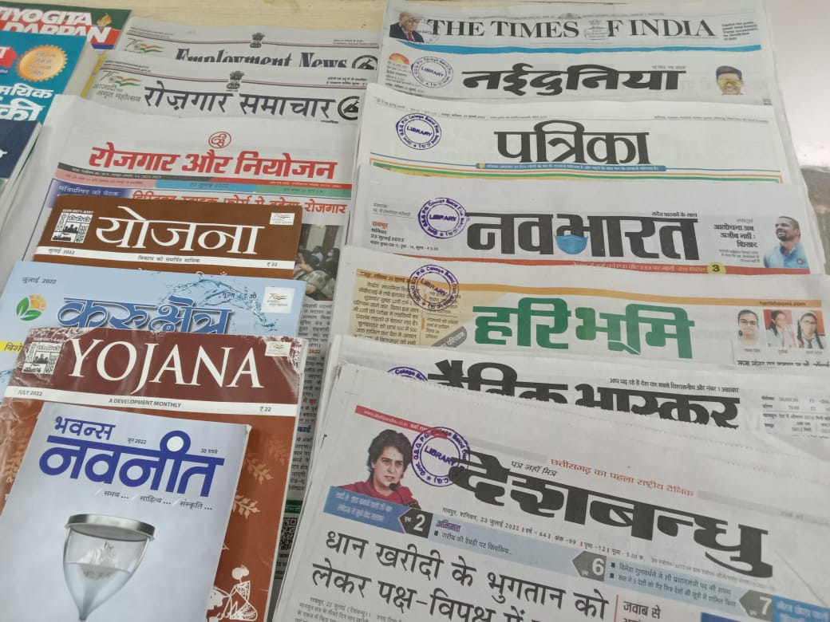
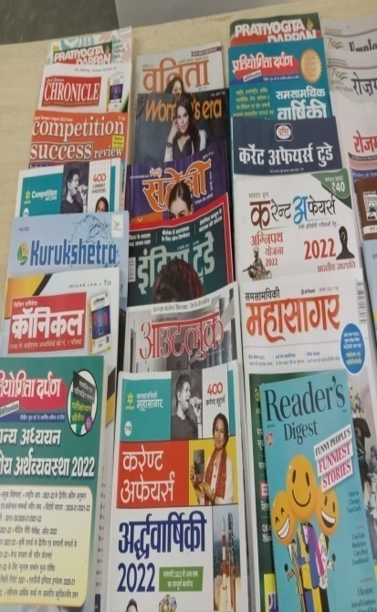
NEWS PAPER / MAGAZINES
NEWS PAPERS
01. Nava Bharat
02. Dainik Bhaskar
03. Nai Duniya
04. Patrika
05. Hari Bhumi
06. Times of India
07. Desh Bandhu
08. Rojgar Samachar
09. Employment News
10. Rojgar aur Niyojan
Magazine
Competition Success Review
Civil Service Chronicle
Pratiyogita Darpan
Yojana
India Today
Reader's Digest
Woman's Era
Meri Saheli
Current affairs
Kurukshetra
Out Look , Etc.

Slide 23
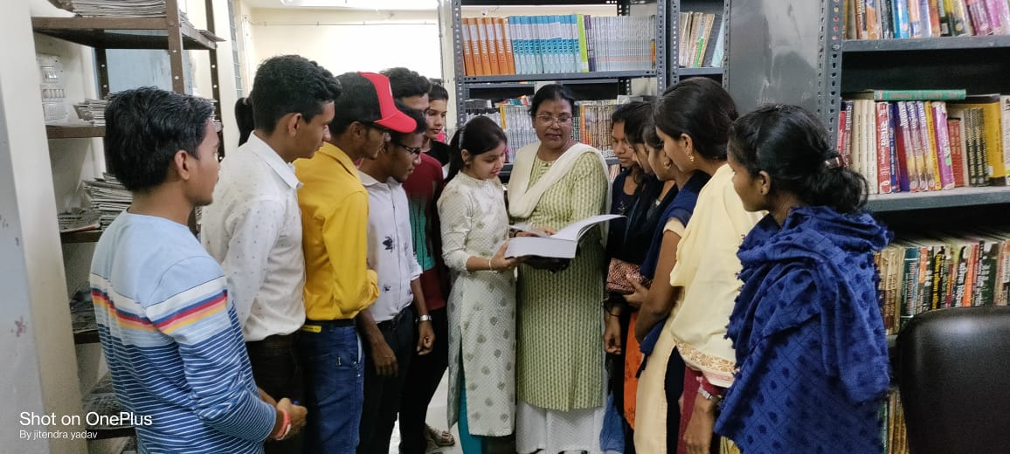
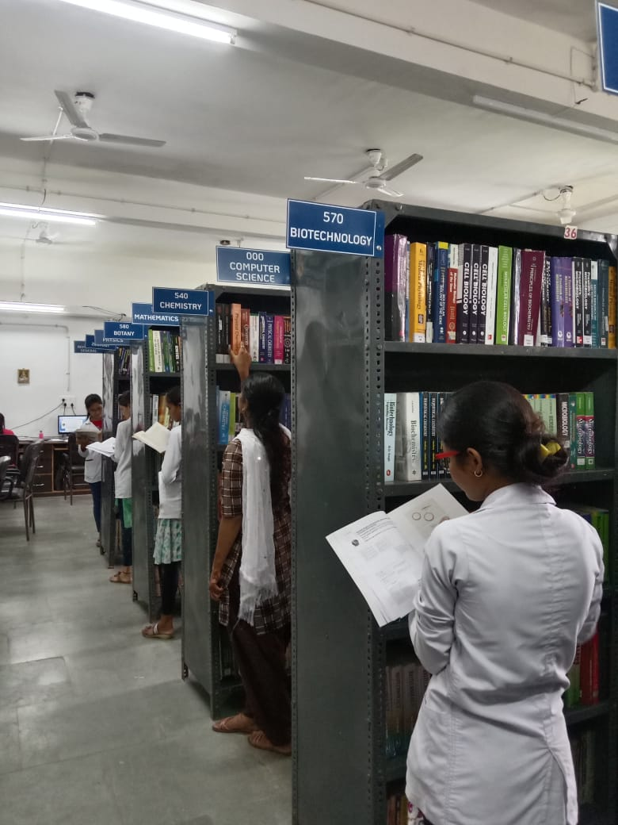
Student Library Visit

Slide 24
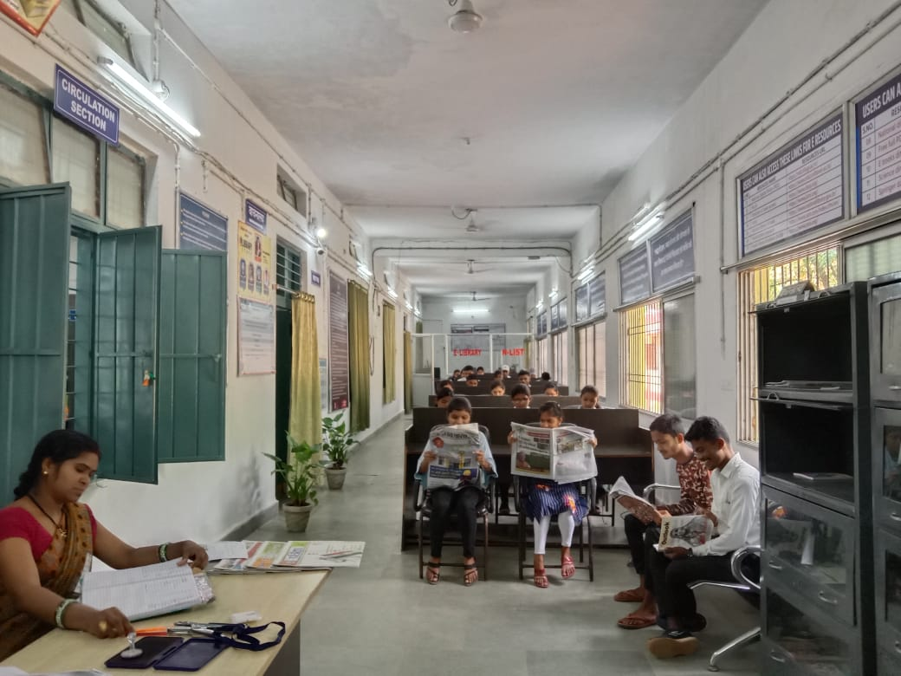
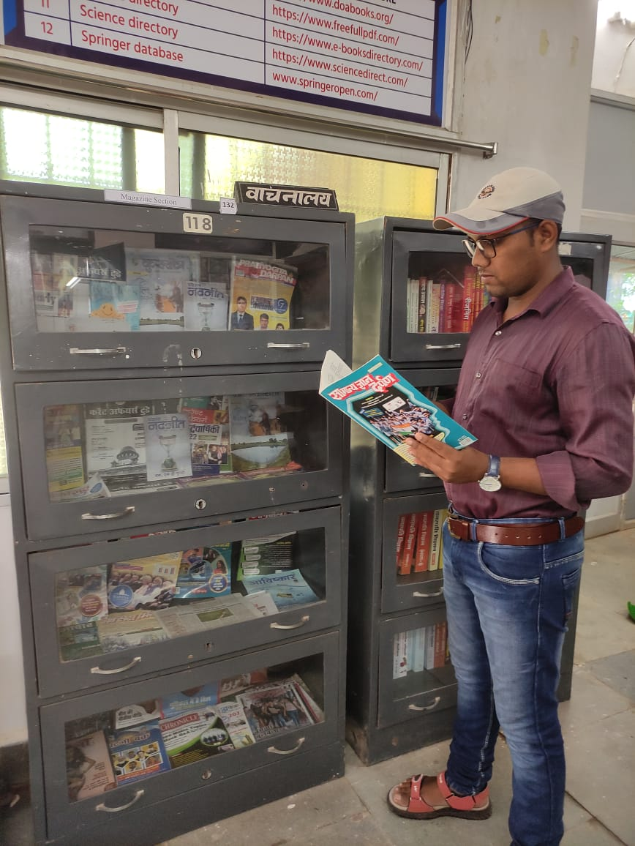
LIBRARY READING ROOM

Slide 25
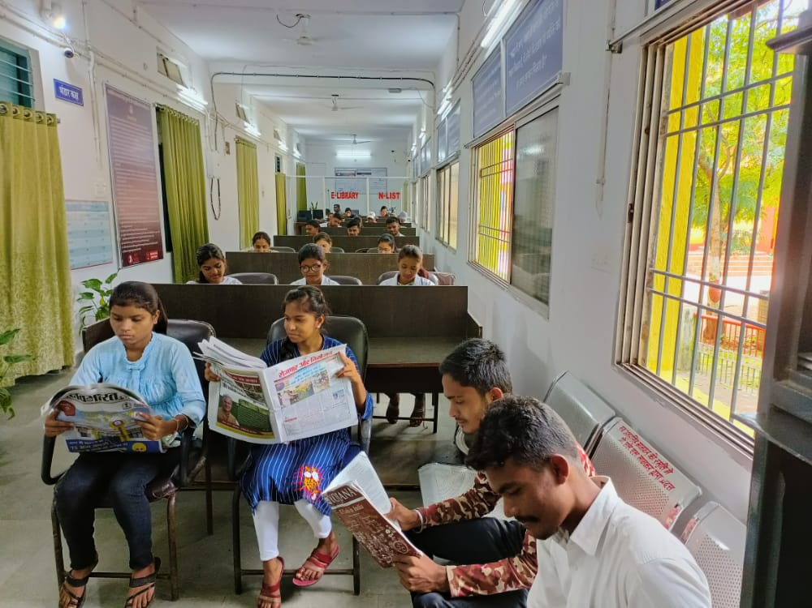
LIBRARY READING ROOM

Slide 26
JOURNALS
All India Reporter Bulletin of materials science Law Profiles The mathematics Education 'kks/k midze vkfFkZd txr~ Glodal Journal of emerging economic Economic Research i;kZoj.k mtkZ VkbEl Yojana Human Development Report Chhattisgarh m|ksx O;kikj if=dk mM+ku dke;kch ds nl lky yksd vlj Indian Library Refresher Advances in management University News NRrhlx<+h lEizs"k.k fo/kkf;uh MARG Glodal Journal of emerging economic Kurukshetra | Social sciences humanities sciences regional studies 'kks/k leh{kk vkSj ewY;kadu Proceedings Mathematical Sciences Resonance journal of Science education Journal of Astrophysics & Astronomy Pramana journal of physics Sadhana Academy Proceedings in Engineering Sciences Research Journal of Chemistry and Environment Current Science Journal of Genetics Genetics of Eye Diseades Journal of Biosciences Journal of Earth system science Journal of Ravishankar University International Journal for Social Development The Quest a journal of Indian Literature and culture Reader's Digest

Slide 27
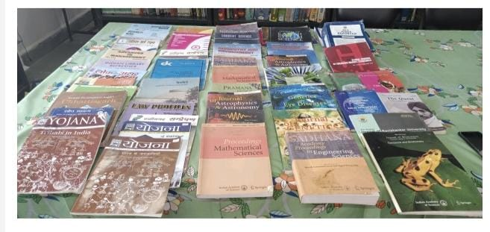
LIBRARY JOURNALS

Slide 28
Library Collections – Electronic Resources (N-LIST).
Swami Vivekanand Library is also has made provisions for its users to access electronic resources through INFLIBNET N-LIST Program.
Swami Vivekananda is part of the N-LIST Programme and has obtained the membership to access N-LIST Electronic Resources since April 2021-22.
S.NO. | RESOUCES NAME | RESOURCES URL
1 | National digital library (NDL) | https://www.doabooks.org/
2 | Free full PDF | https://www.freefullpdf.com/
3 | E books directory | https://www.e-booksdirectory.com/
4 | Science directory | https://www.sciencedirect.com/
5 | Springer database | www.springeropen.com/

Slide 29
Library Collections – Electronic Resources (N-LIST).
S.NO. | RESOUCES NAME | RESOURCES URL
6 | National digital library (NDL) | https://ndl.iitkgp.ac.in/
7 | N - List | https://www.nlist.inflibnet.ac.in/
8 | Directory of open access journals | https://www.doaj.org/
9 | J-stor | https://www.jstor.org/
10 | National library of India | https://www.nationallibrary.gov.in/
11 | Social science research network (SSRN) | https://www.ssrn.com/index.cfm/en/
12 | Public library of science (PLOS) | https://www.plos.org/
13 | About e-PG Pathshala | https://epgp.inflibnet.ac.in/

Slide 30
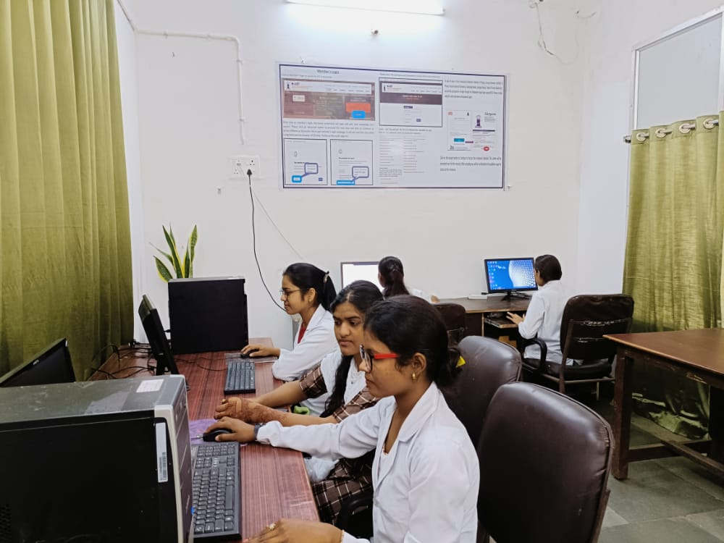
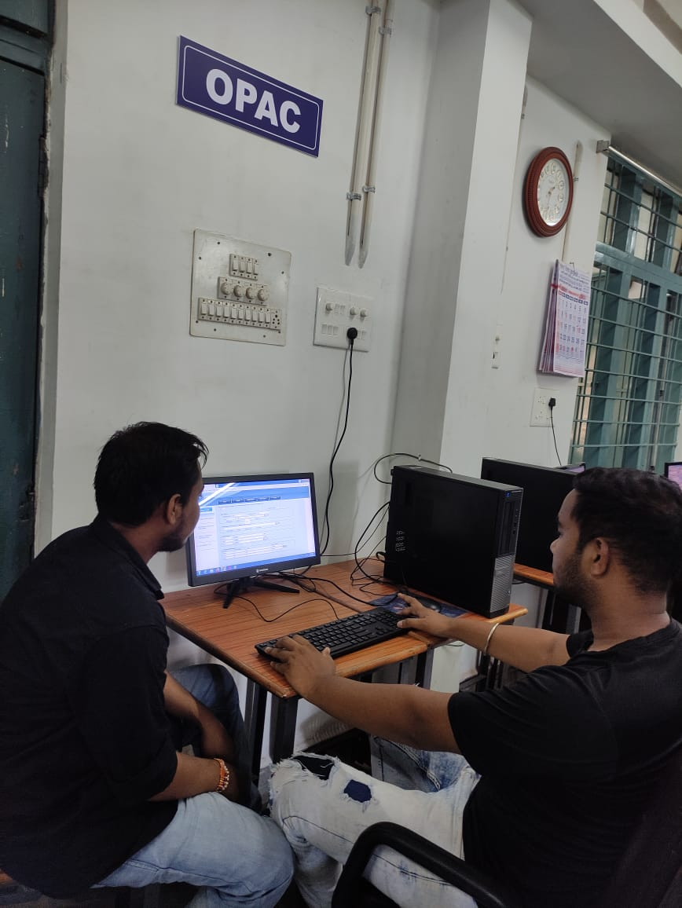
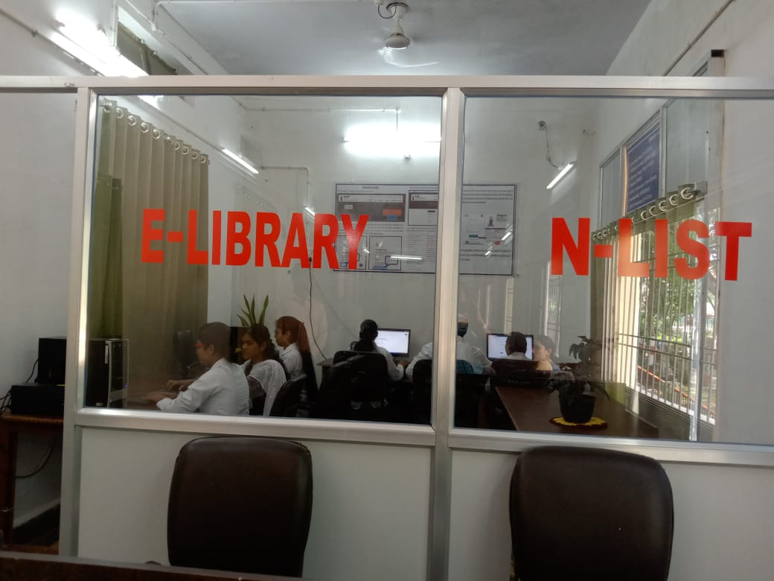
E - Library

Slide 31
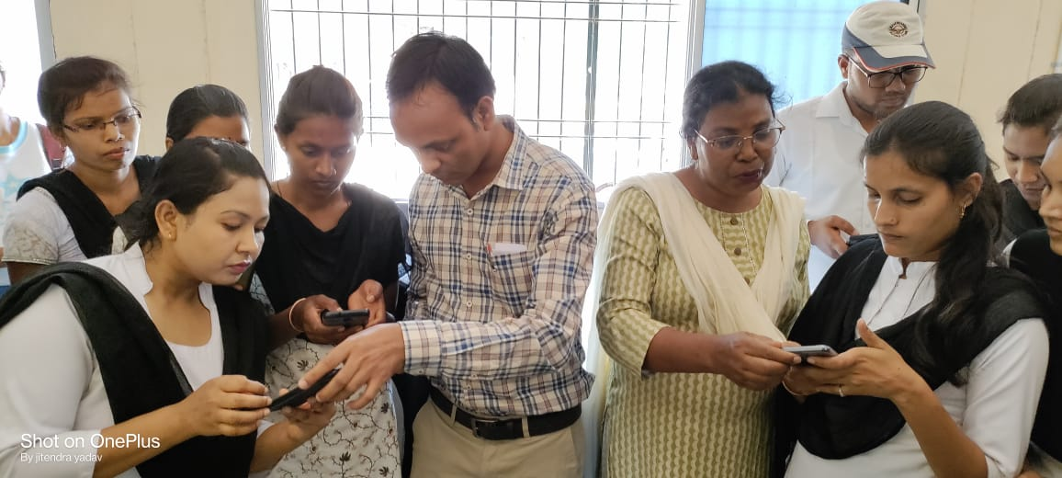
STUDENT N-LIST MEMBERSHIP

Slide 32
LIBRARY ORIENTATION PROGRAM
Library orientation program is organized every year for new comers at beginning of the academic year.
Brief Introduction about use of Library , E-Library
Use of Library Resources
How Library circulation works.
Reference service for students
Library and reading room rules and regulations.

Slide 33
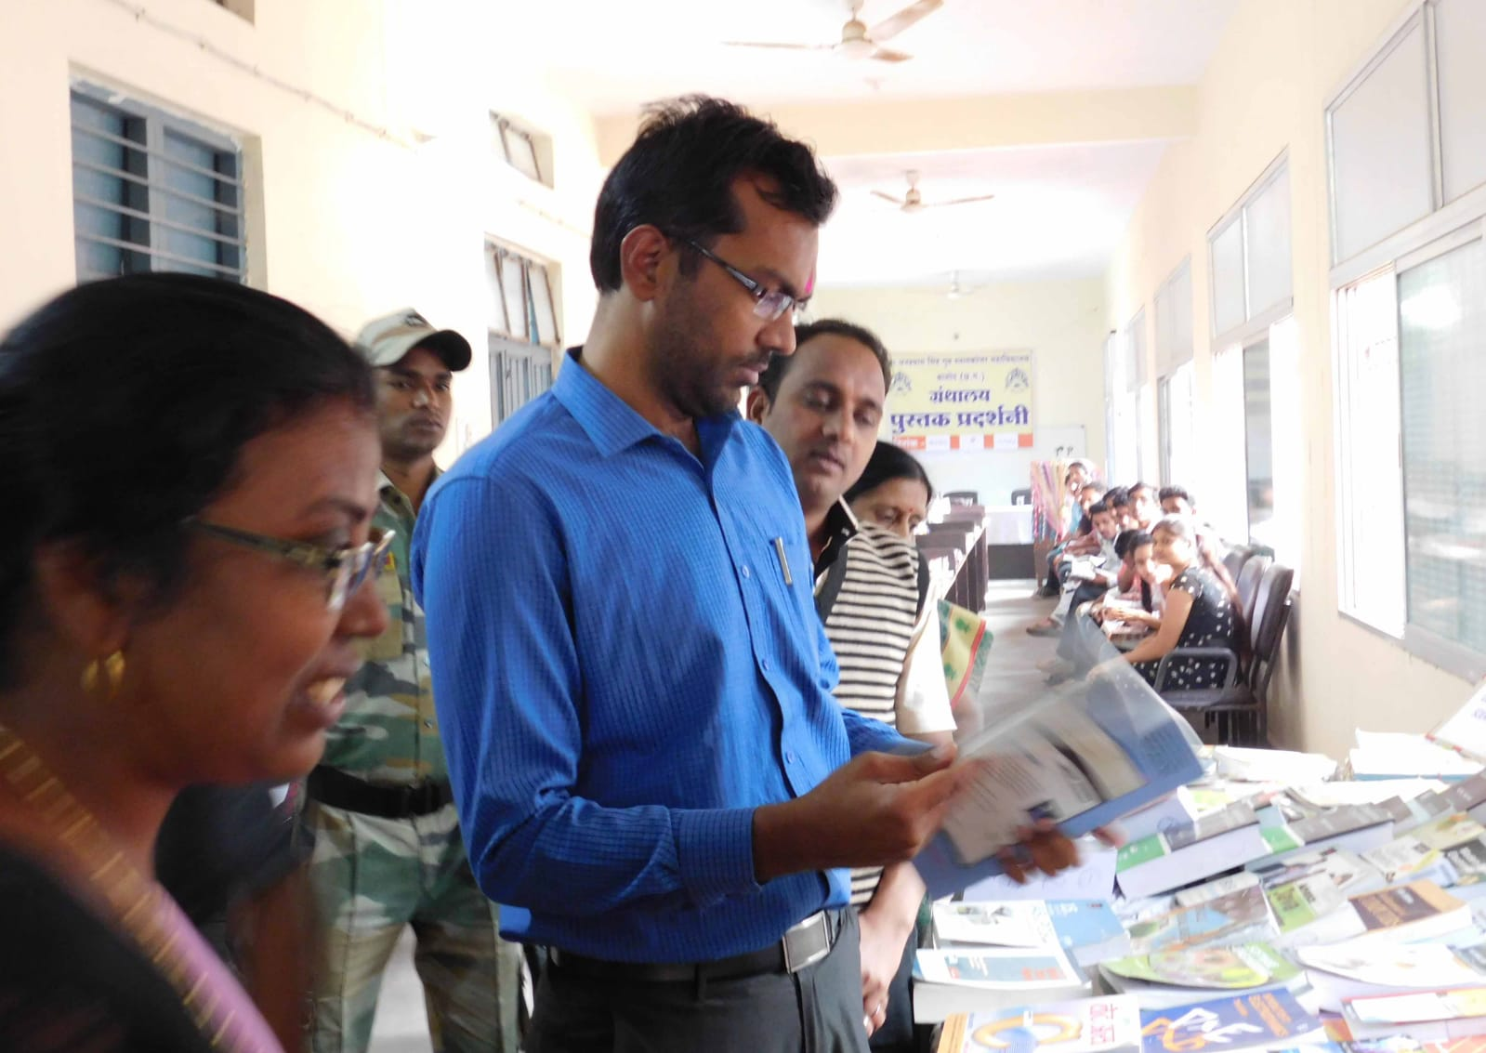
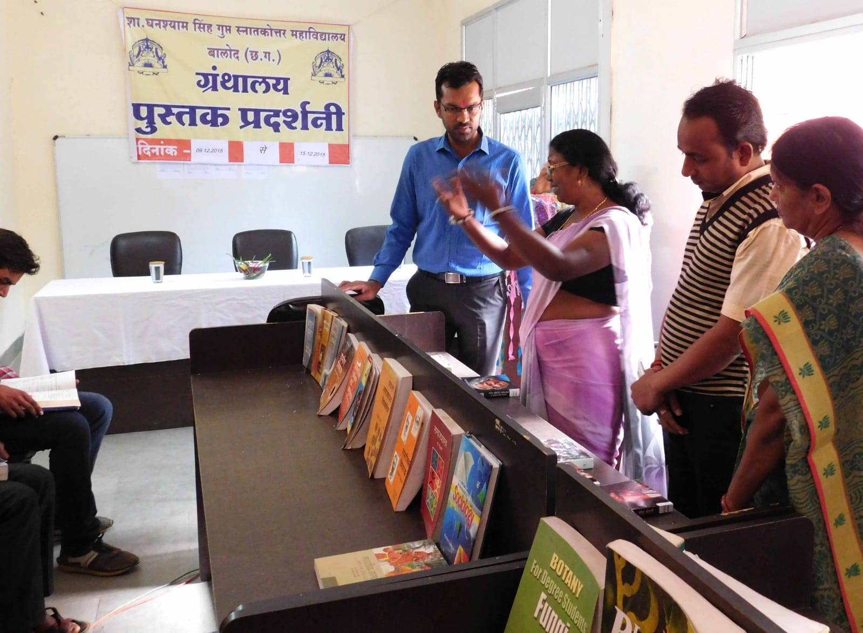
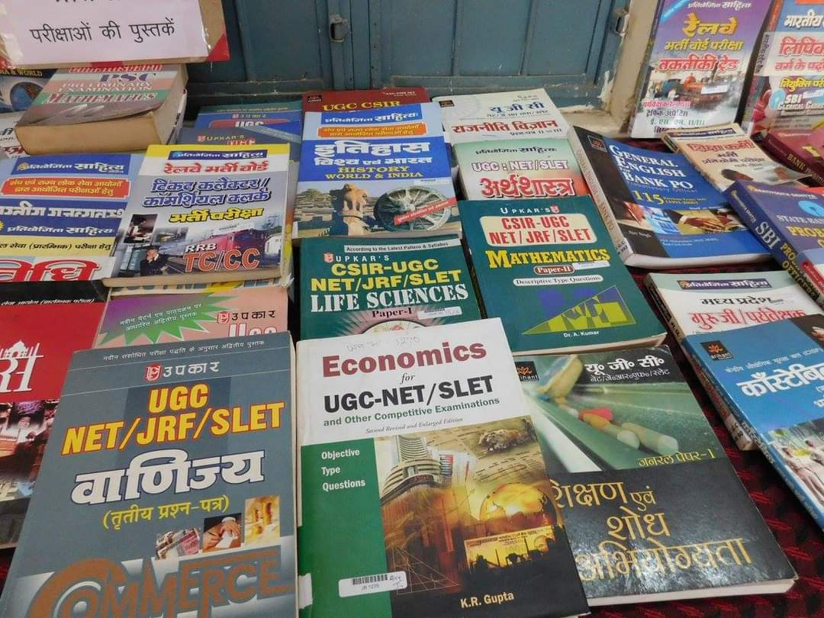
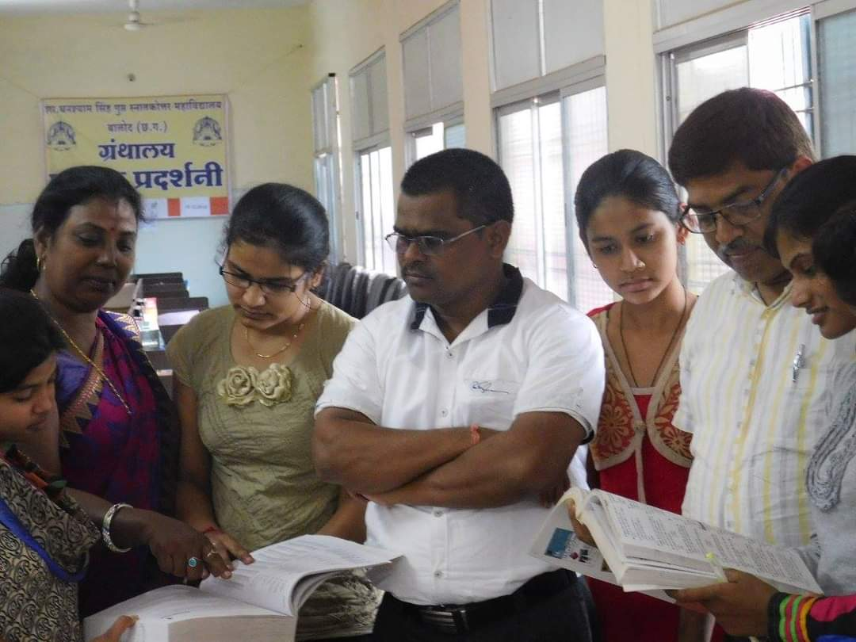
District Collector Mr. Rajesh Rana in Inaugural Book Exhibition and Career Guidance function.

Slide 34
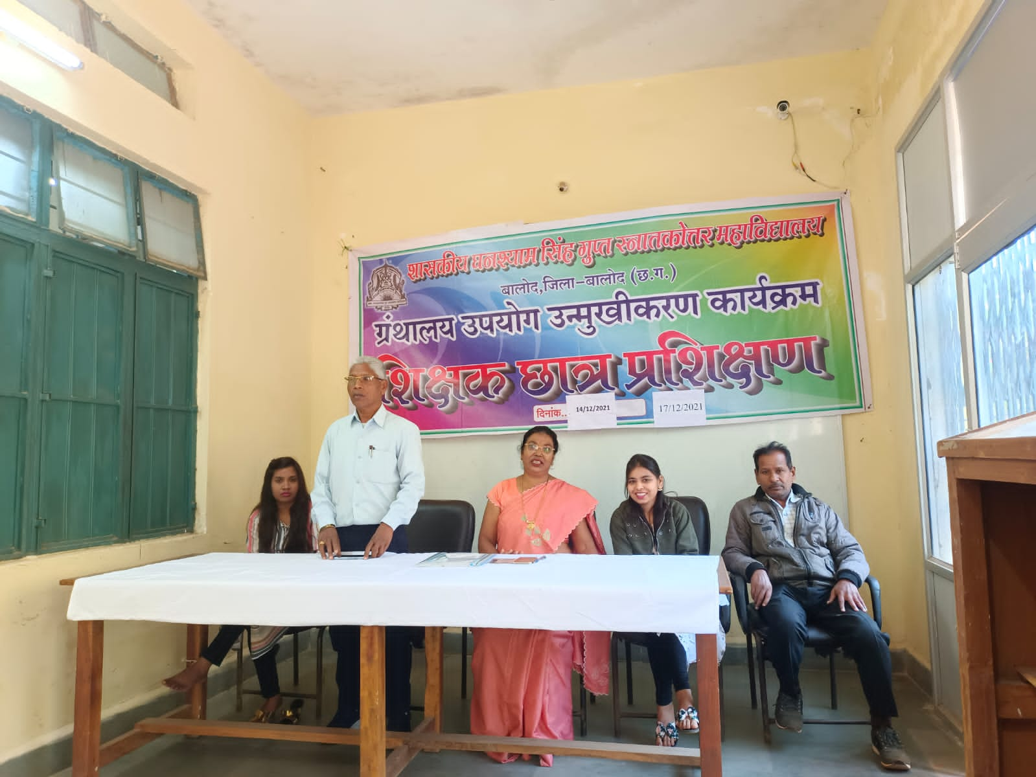
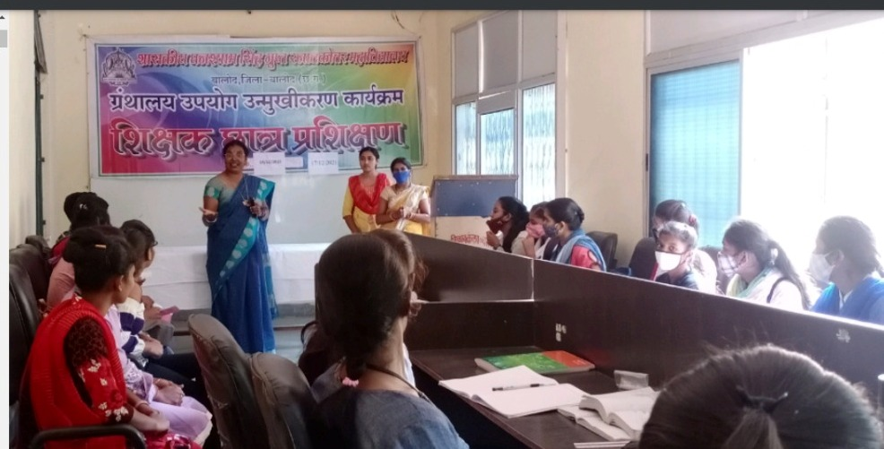
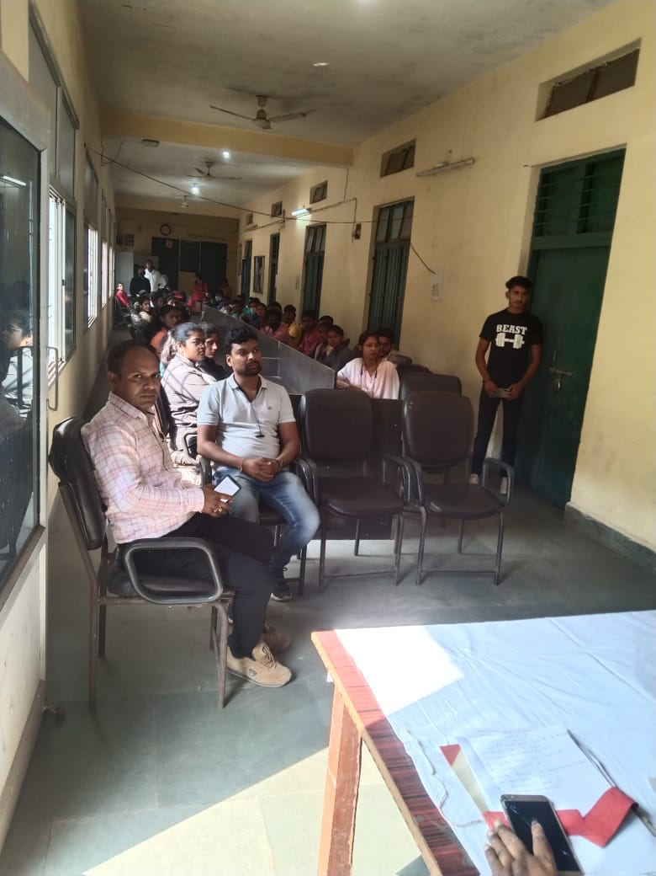
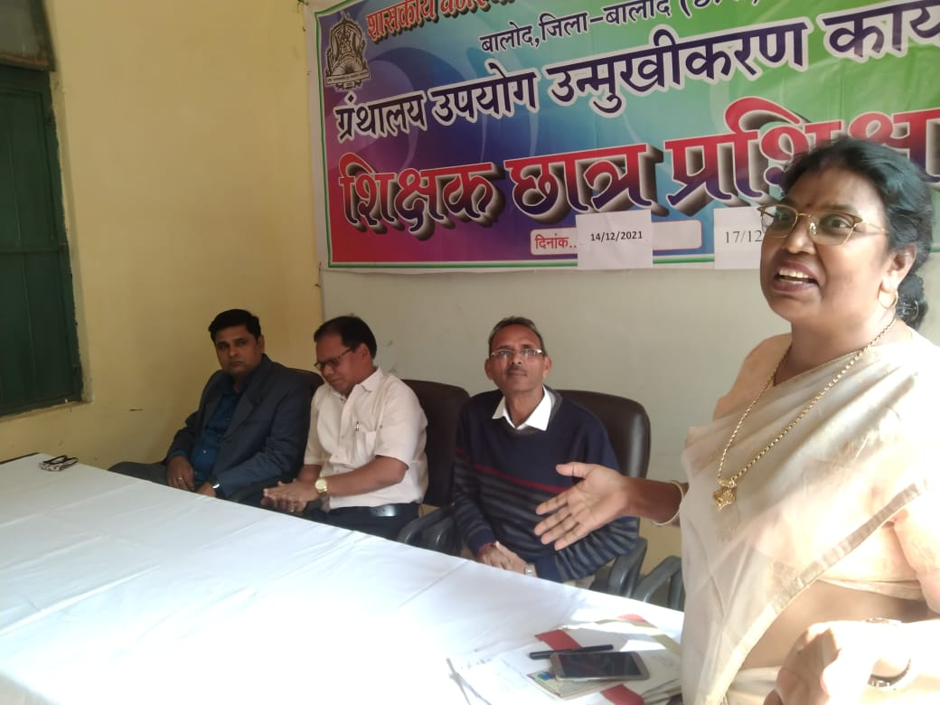
LIBRARY ORIENTATION PROGRAM SESSION 2021-22

Slide 35
PUBLIC LIBRARY
Distinguished Feature of The College Library :-
Swami Vivekanand Library Provides Facility of Public Library. This Central library of lead College in Balod District caters to the need of Common citizens, officers and Administrative officers keeping interest in reading and Literature.
Thus Library imparts facility and fulfils demand of all public belonging to above mentioned different category. Service of Providing referred books and reading room is open to readers according to Time table Schedule.
Public Library Timings 3.00pm to 5.00pm.

Slide 36
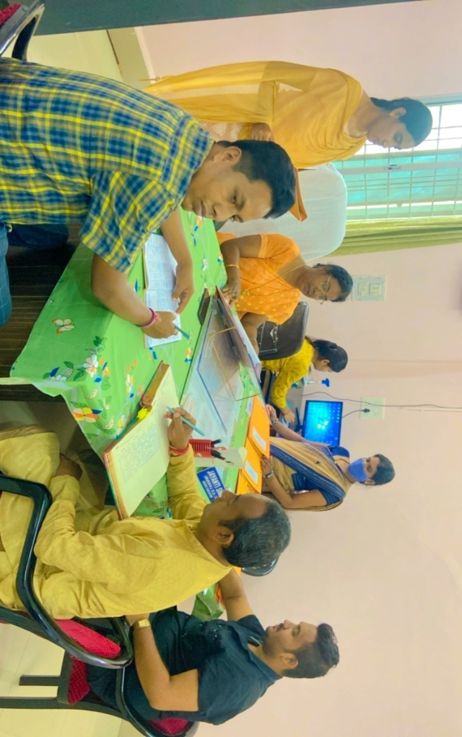
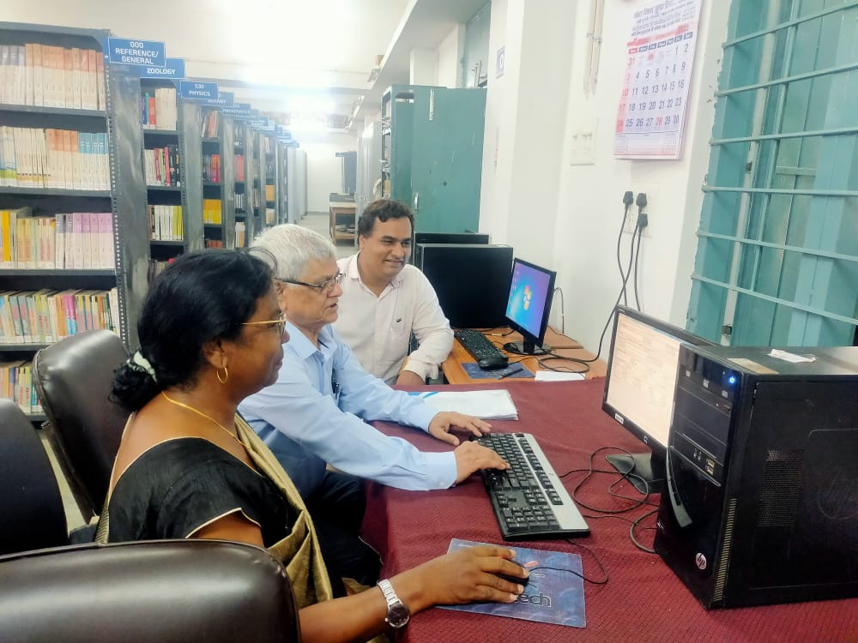
PUBLIC LIBRARY

Slide 37
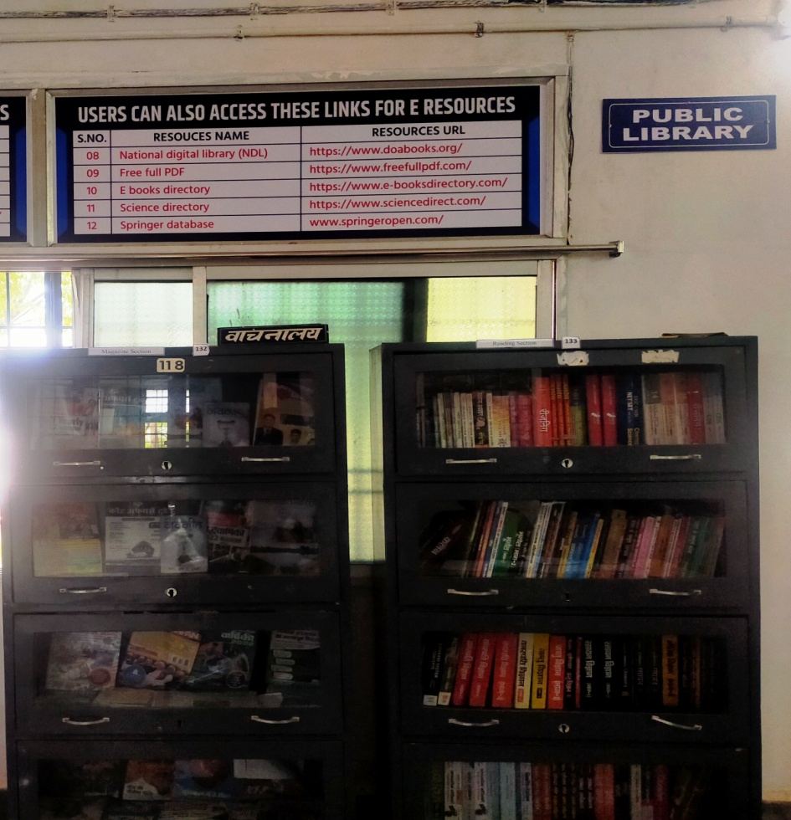
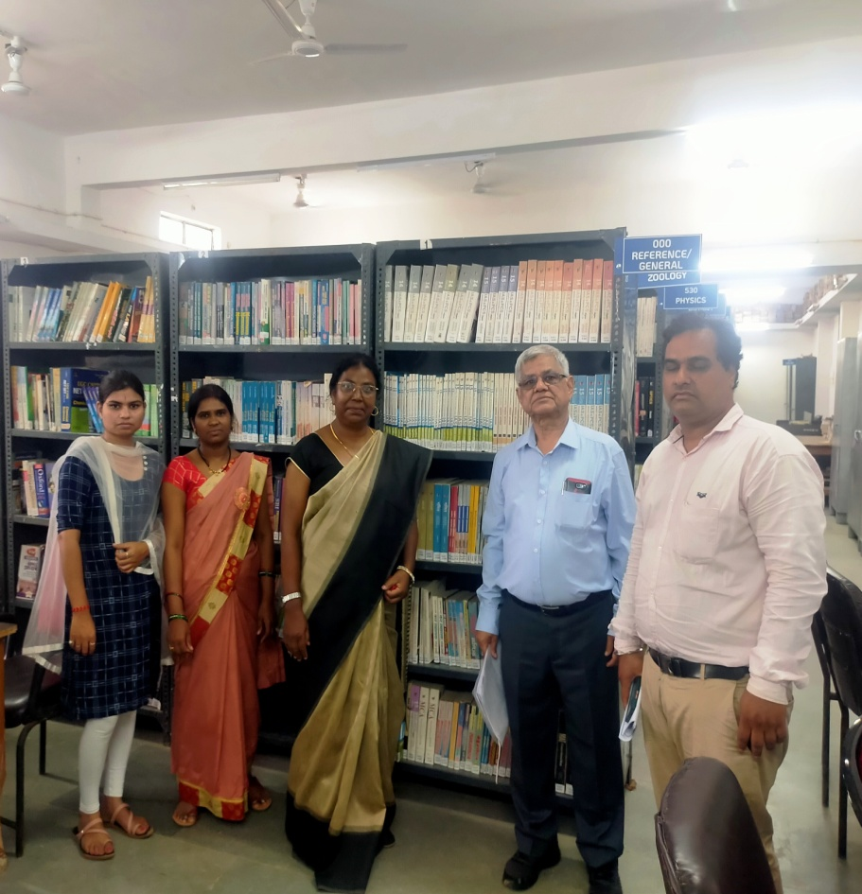
PUBLIC LIBRARY

Slide 38
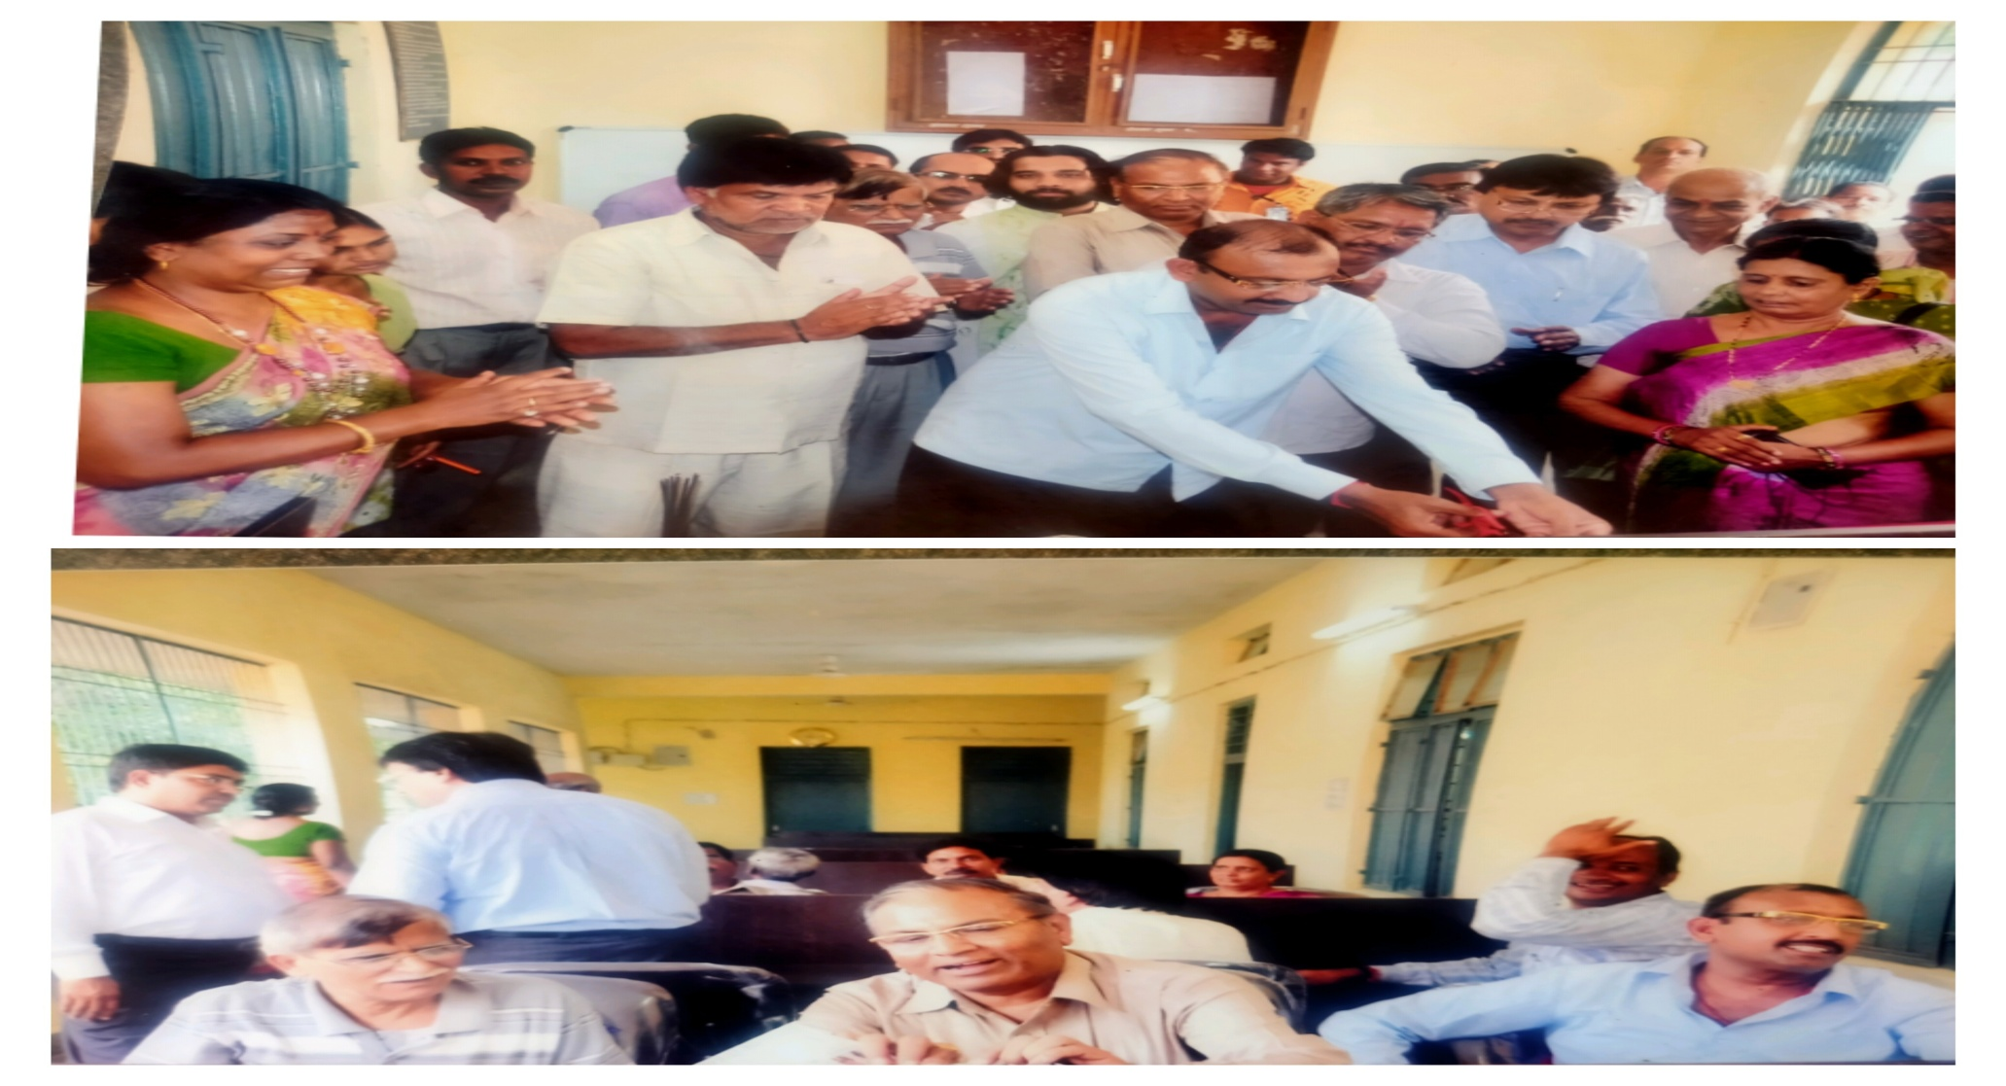
LIBRARY COLLECTION READING ROOM (Opening 2011)

Slide 39
FUTURE PLAN OF LIBRARY
Fully automation of library.
Motivate students and staff to inculcate reading habits available though
E-Resource.
Frequent organization of orientation Program for upgrading students and staff for using E-Resources.
In future if college opens research center in different department, Library Shall abide to fulfill the needs of research work.

Slide 40
THANK you

